Slide 1
Dynamic Memory Allocation: Basic Concepts 15-213/18-213/15-513: Introduction to Computer Systems 13th Lecture, October 12, 2021

Slide 2
Announcements
No lecture on Thursday October 14
Malloclab out today
Checkpoint due on Tuesday October 26 (+ up to 2 grace days)
Final submission due on Tuesday November 2 (+ up to 2 grace days)

Slide 3
Today
Basic concepts
Implicit free lists

Slide 4
Dynamic Memory Allocation
Memory
invisible to
user code
Application
Kernel virtual memory
Dynamic Memory Allocator
User stack
(created at runtime)
Heap
%rsp
(stack
pointer)
Programmers use dynamic memory allocators (such as malloc) to acquire virtual memory (VM) at runtime
For data structures whose size is only known at runtime
Dynamic memory allocators manage an area of process VM known as the heap
Memory-mapped region for
shared libraries
brk
Run-time heap
(created by malloc)
Read/write segment
(.data, .bss)
Loaded
from
the
executable
file
Read-only segment
(.init, .text, .rodata)
0x400000
Unused
0

Slide 5
Dynamic Memory Allocation
Allocator maintains heap as collection of variable sized blocks, which are either allocated or free
Types of allocators
Explicit allocator: application allocates and frees space
e.g., malloc and free in C
Implicit allocator: application allocates, but does not free space
e.g., new and garbage collection in Java
Will discuss simple explicit memory allocation today

Slide 6
The malloc Package
#include <stdlib.h>
void *malloc(size_t size)
Successful:
Returns a pointer to a memory block of at least size bytes aligned to a 16-byte boundary (on x86-64)
If size == 0, returns NULL
Unsuccessful: returns NULL (0) and sets errno
void free(void *p)
Returns the block pointed at by p to pool of available memory
p must come from a previous call to malloc, calloc, or realloc
Other functions
calloc: Version of malloc that initializes allocated block to zero
realloc: Changes the size of a previously allocated block
sbrk: Used internally by allocators to grow or shrink the heap

Slide 7
malloc Example
#include <stdio.h>
#include <stdlib.h>
void foo(long n) {
long i, *p;
/* Allocate a block of n longs */
p = (long *) malloc(n * sizeof(long));
if (p == NULL) {
perror("malloc");
exit(0);
}
/* Initialize allocated block */
for (i=0; i<n; i++)
p[i] = i;
/* Do something with p */
. . .
/* Return allocated block to the heap */
free(p);
}

Slide 8
Sample Implementation
Code
File mm-reference.c
Manages fixed size heap
Functions mm_malloc, mm_free
Features
Based on words of 8-bytes each
Pointers returned by malloc are double-word aligned
Double word = 2 words
Compile and run tests with command interpreter

Slide 9
Visualization Conventions
Show 8-byte words as squares
Allocations are double-word aligned
Allocated block
(4 words)
Free block
(2 words)
Free word
Allocated word

Slide 10
Allocation Example (Conceptual)
#define SIZ sizeof(size_t)
p1 = malloc(4*SIZ)
p2 = malloc(5*SIZ)
p3 = malloc(6*SIZ)
free(p2)
p4 = malloc(2*SIZ)

Slide 11
Constraints
Applications
Can issue arbitrary sequence of malloc and free requests
free request must be to a malloc’d block
Explicit Allocators
Can’t control number or size of allocated blocks
Must respond immediately to malloc requests
i.e., can’t reorder or buffer requests
Must allocate blocks from free memory
i.e., can only place allocated blocks in free memory
Must align blocks so they satisfy all alignment requirements
16-byte (x86-64) alignment on 64-bit systems
Can manipulate and modify only free memory
Can’t move the allocated blocks once they are malloc’d
i.e., compaction is not allowed. Why not?

Slide 12
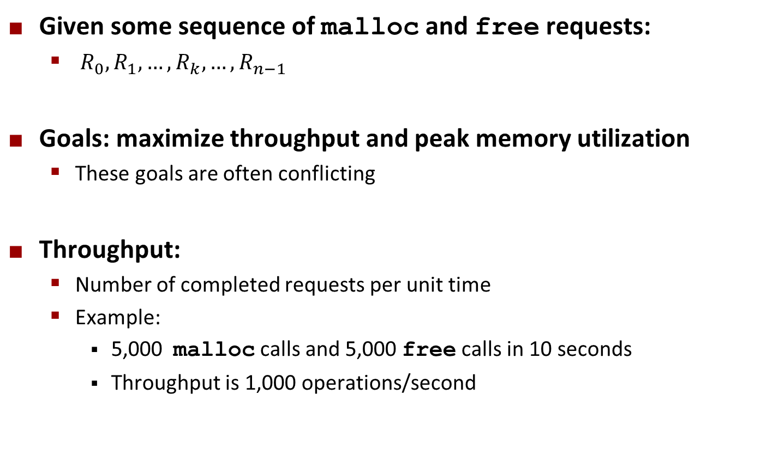
Performance Goal: Throughput
Given some sequence of malloc and free requests:
$R_{0}, R_{1},…, R_{k},…,R_{n−1}$
Goals: maximize throughput and peak memory utilization
These goals are often conflicting
Throughput:
Number of completed requests per unit time
Example:
5,000 malloc calls and 5,000 free calls in 10 seconds
Throughput is 1,000 operations/second

Slide 13
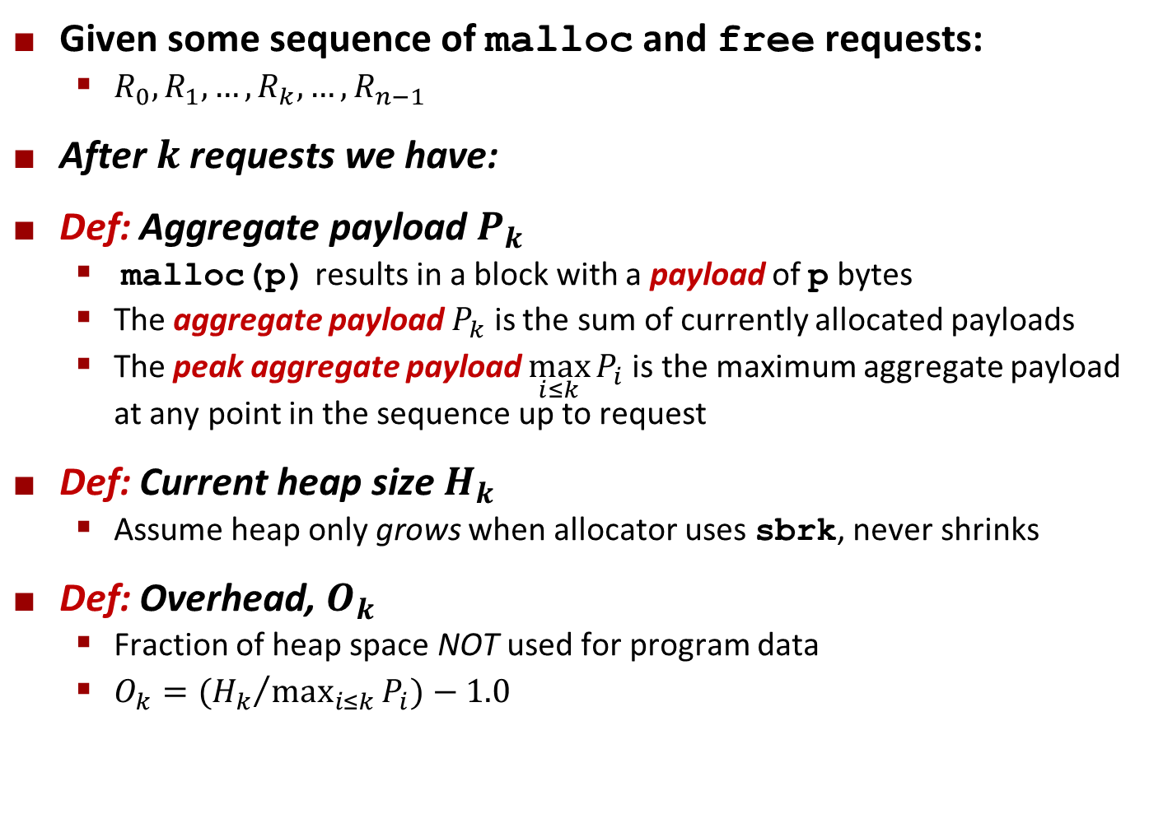
Performance Goal: Minimize Overhead
Given some sequence of malloc and free requests:
$R_{0}, R_{1},…, R_{k},…,R_{n−1}$
After $k$ requests we have:
Def: Aggregate payload $P_{k}$
malloc(p) results in a block with a payload of p bytes
The aggregate payload $P_{k}$ is the sum of currently allocated payloads
The peak aggregate payload $\max_{i≤k}{P_{i}}$is the maximum aggregate payload at any point in the sequence up to request
Def: Current heap size $H_{k}$
Assume heap only grows when allocator uses sbrk, never shrinks
Def: Overhead, $O_{k}$
Fraction of heap space NOT used for program data
$O_{k}=({H_{k}}/{\max_{i≤k}{P_{i}}})−1.0$

Slide 14
Benchmark Example
Step | Command | Delta | Allocated | Peak
1 | a 0 9904 | 9904 | 9904 | 9904
2 | a 1 50084 | 50084 | 59988 | 59988
3 | a 2 20 | 20 | 60008 | 60008
4 | a 3 16784 | 16784 | 76792 | 76792
5 | f 3 | -16784 | 60008 | 76792
6 | a 4 840 | 840 | 60848 | 76792
7 | a 5 3244 | 3244 | 64092 | 76792
8 | f 0 | -9904 | 54188 | 76792
9 | a 6 2012 | 2012 | 56200 | 76792
10 | f 2 | -20 | 56180 | 76792
11 | a 7 33856 | 33856 | 90036 | 90036
12 | f 1 | -50084 | 39952 | 90036
13 | a 8 136 | 136 | 40088 | 90036
14 | f 7 | -33856 | 6232 | 90036
15 | f 6 | -2012 | 4220 | 90036
16 | a 9 20 | 20 | 4240 | 90036
17 | f 4 | -840 | 3400 | 90036
18 | f 8 | -136 | 3264 | 90036
19 | f 5 | -3244 | 20 | 90036
20 | f 9 | -20 | 0 | 90036
Benchmark
syn-array-short
Trace provided with malloc lab
Allocate & free 10 blocks
a = allocate
f = free
Bias toward allocate at beginning & free at end
Blocks number 1–10
Allocated: Sum of all allocated amounts
Peak: Max so far of Allocated

Slide 15
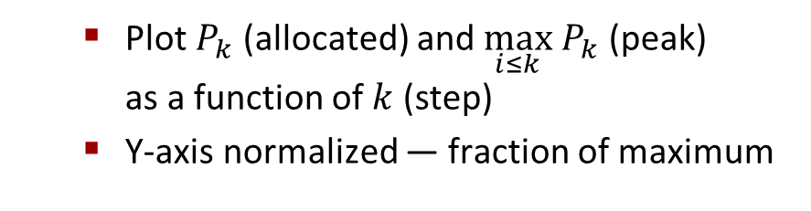
Benchmark Visualization
Step | Command | Delta | Allocated | Peak
1 | a 0 9904 | 9904 | 9904 | 9904
2 | a 1 50084 | 50084 | 59988 | 59988
3 | a 2 20 | 20 | 60008 | 60008
4 | a 3 16784 | 16784 | 76792 | 76792
5 | f 3 | -16784 | 60008 | 76792
6 | a 4 840 | 840 | 60848 | 76792
7 | a 5 3244 | 3244 | 64092 | 76792
8 | f 0 | -9904 | 54188 | 76792
9 | a 6 2012 | 2012 | 56200 | 76792
10 | f 2 | -20 | 56180 | 76792
11 | a 7 33856 | 33856 | 90036 | 90036
12 | f 1 | -50084 | 39952 | 90036
13 | a 8 136 | 136 | 40088 | 90036
14 | f 7 | -33856 | 6232 | 90036
15 | f 6 | -2012 | 4220 | 90036
16 | a 9 20 | 20 | 4240 | 90036
17 | f 4 | -840 | 3400 | 90036
18 | f 8 | -136 | 3264 | 90036
19 | f 5 | -3244 | 20 | 90036
20 | f 9 | -20 | 0 | 90036
Plot $P_{k}$ (allocated) and $\max_{i≤k} P_{k}$ (peak) as a function of $k$ (step)
Y-axis normalized — fraction of maximum

Slide 16
Typical Benchmark Behavior
Peak
Allocated
Longer sequence of mallocs & frees (40,000 blocks)
Starts with all mallocs, and shifts toward all frees
Allocator must manage space efficiently the whole time
Production allocators can shrink the heap

Slide 17
Fragmentation
Poor memory utilization caused by fragmentation
Internal fragmentation
External fragmentation

Slide 18
Internal Fragmentation
For a given block, internal fragmentation occurs if payload is smaller than block size
Caused by
Overhead of maintaining heap data structures
Padding for alignment purposes
Explicit policy decisions (e.g., to return a big block to satisfy a small request)
Depends only on the pattern of previous requests
Thus, easy to measure
Block
Internal
fragmentation
Payload
Internal
fragmentation

Slide 19
Internal Fragmentation Effect
Peak + Internal Frag
Peak
Allocated
Purple line: additional heap size due to allocator’s data + padding for alignment
For this benchmark, 1.5% overhead
Cannot achieve in practice
Especially since cannot move allocated blocks

Slide 20
External Fragmentation
#define SIZ sizeof(size_t)
Occurs when there is enough aggregate heap memory, but no single free block is large enough
Depends on the pattern of future requests
Thus, difficult to measure
p1 = malloc(4*SIZ)
p2 = malloc(5*SIZ)
p3 = malloc(6*SIZ)
free(p2)
p4 = malloc(7*SIZ)
Yikes! (what would happen now?)

Slide 21
External Fragmentation Effect
Peak + All Frag (Best Fit)
Peak + Internal Frag
Peak
Allocated
Green line: additional heap size due to external fragmentation
Best Fit: One allocation strategy
(To be discussed later)
Total overhead = 8.3% on this benchmark

Slide 22
Implementation Issues
How do we know how much memory to free given just a pointer?
How do we keep track of the free blocks?
What do we do with the extra space when allocating a structure that is smaller than the free block it is placed in?
How do we pick a block to use for allocation -- many might fit?
How do we reuse a block that has been freed?

Slide 23
Knowing How Much to Free
Standard method
Keep the length (in bytes) of a block in the word preceding the block.
Including the header
This word is often called the header field or header
Requires an extra word for every allocated block
p0
p0 = malloc(4*SIZ)
48
block size
Payload (aligned)
Padding
(for alignment)
free(p0)

Slide 24
Keeping Track of Free Blocks
Method 1: Implicit list using length—links all blocks
Method 2: Explicit list among the free blocks using pointers
Method 3: Segregated free list
Different free lists for different size classes
Method 4: Blocks sorted by size
Can use a balanced tree (e.g., Red-Black tree) with pointers within each free block, and the length used as a key
Need to tag
each block as
allocated/free
Unused
32
48
32
16
Need space
for pointers
32
48
32
16

Slide 25
Today
Basic concepts
Implicit free lists

Slide 26
Method 1: Implicit Free List
For each block we need both size and allocation status
Could store this information in two words: wasteful!
Standard trick
When blocks are aligned, some low-order address bits are always 0
Instead of storing an always-0 bit, use it as an allocated/free flag
When reading the Size word, must mask out this bit
1 word
Size
a
a = 1: Allocated block
a = 0: Free block
Size: total block size
Payload: application data
(allocated blocks only)
Format of
allocated and
free blocks
Payload
Optional
padding

Slide 27
Detailed Implicit Free List Example
End
Block
Start
of
heap
Unused
16/0
32/1
64/0
32/1
8/1
heap_start
heap_end
Double-word
aligned
Allocated blocks: shaded
Free blocks: unshaded
Headers: labeled with “size in words/allocated bit”
Headers are at non-aligned positions
➔ Payloads are aligned

Slide 28
Implicit List: Data Structures
header
payload
Block declaration
Getting payload from block pointer
Getting header from payload
typedef uint64_t word_t;
typedef struct block
{
word_t header;
unsigned char payload[0];
} block_t;
// Zero length array
// block_t *block
return (void *) (block->payload);
// bp points to a payload
return (block_t *) ((unsigned char *) bp
- offsetof(block_t, payload));
C function offsetof(struct, member) returns offset of member within struct

Slide 29
Implicit List: Header access
Size
a
Getting allocated bit from header
Getting size from header
Initializing header
return header & 0x1;
return header & ~0xfL;
// block_t *block
block->header = size | alloc;

Slide 30
Implicit List: Traversing list
header
payload
unused
header
payload
block size
Find next block
static block_t *find_next(block_t *block)
{
return (block_t *) ((unsigned char *) block
+ get_size(block));
}
End
Block
Unused
16/0
32/1
64/0
32/1
8/1

Slide 31
Implicit List: Finding a Free Block
First fit:
Search list from beginning, choose first free block that fits:
Finding space for asize bytes (including header):
static block_t *find_fit(size_t asize)
{
block_t *block;
for (block = heap_start; block != heap_end;
block = find_next(block)) {
{
if (!(get_alloc(block))
&& (asize <= get_size(block)))
return block;
}
return NULL; // No fit found
}
heap_start
heap_end
16/0
32/1
64/0
32/1
8/1

Slide 32
Implicit List: Finding a Free Block
First fit:
Search list from beginning, choose first free block that fits:
Can take linear time in total number of blocks (allocated and free)
In practice it can cause “splinters” at beginning of list
Next fit:
Like first fit, but search list starting where previous search finished
Should often be faster than first fit: avoids re-scanning unhelpful blocks
Some research suggests that fragmentation is worse
Best fit:
Search the list, choose the best free block: fits, with fewest bytes left over
Keeps fragments small—usually improves memory utilization
Will typically run slower than first fit
Still a greedy algorithm. No guarantee of optimality

Slide 33
Comparing Strategies
Total Overheads (for this benchmark)
Perfect Fit: 1.6%
Best Fit: 8.3%
First Fit: 11.9%
Next Fit: 21.6%

Slide 34
Implicit List: Allocating in Free Block
Allocating in a free block: splitting
Since allocated space might be smaller than free space, we might want to split the block
32
32
48
16
8
p
split_block(p, 32)
32
32
32
16
16
8

Slide 35
Implicit List: Splitting Free Block
split_block(p, 32)
64
16
32
32
16
p
// Warning: This code is incomplete
static void split_block(block_t *block, size_t asize){
size_t block_size = get_size(block);
if ((block_size - asize) >= min_block_size) {
write_header(block, asize, true);
block_t *block_next = find_next(block);
write_header(block_next, block_size - asize, false);
}

Slide 36
Implicit List: Freeing a Block
Simplest implementation:
Need only clear the “allocated” flag
But can lead to “false fragmentation”
32
32
32
16
16
8
free(p)
p
32
32
32
16
16
8
malloc(5*SIZ)
Yikes!
There is enough contiguous
free space, but the allocator won’t be able to find it

Slide 37
Implicit List: Coalescing
Join (coalesce) with next/previous blocks, if they are free
Coalescing with next block
32
32
32
16
16
8
logically
gone
free(p)
p
32
32
48
16
16
1

Slide 38
Implicit List: Coalescing
Join (coalesce) with next block, if it is free
Coalescing with next block
How do we coalesce with previous block?
How do we know where it starts?
How can we determine whether its allocated?
64
32
16
16
8
logically
gone
free(p)
p
64
48
16
16
8

Slide 39
Implicit List: Bidirectional Coalescing
Boundary tags [Knuth73]
Replicate size/allocated word at “bottom” (end) of free blocks
Allows us to traverse the “list” backwards, but requires extra space
Important and general technique!
8
32
32
32
32
48
48
32
32
8
Header
Size
a
a = 1: Allocated block
a = 0: Free block
Size: Total block size
Payload: Application data
(allocated blocks only)
Format of
allocated and
free blocks
Payload and
padding
Boundary tag
(footer)
Size
a

Slide 40
Quiz
https://canvas.cmu.edu/courses/24383/quizzes/67237

Slide 41
Implementation with Footers
header
payload
unused
footer
header
payload
Locating footer of current block
asize
asize
dsize
const size_t dsize = 2*sizeof(word_t);
static word_t *header_to_footer(block_t *block)
{
size_t asize = get_size(block);
return (word_t *) (block->payload + asize - dsize);
}

Slide 42
Implementation with Footers
header
payload
unused
footer
header
payload
Locating footer of previous block
1 word
static word_t *find_prev_footer(block_t *block)
{
return &(block->header) - 1;
}

Slide 43
Splitting Free Block: Full Version
split_block(p, 32)
64
64
16
32
32
32
32
16
p
static void split_block(block_t *block, size_t asize){
size_t block_size = get_size(block);
if ((block_size - asize) >= min_block_size) {
write_header(block, asize, true);
write_footer(block, asize, true);
block_t *block_next = find_next(block);
write_header(block_next, block_size - asize, false);
write_footer(block_next, block_size - asize, false);
}

Slide 44
Constant Time Coalescing
Case 1
Case 2
Case 3
Case 4
Allocated
Allocated
Free
Free
Block being
freed
Allocated
Free
Allocated
Free

Slide 45
Constant Time Coalescing (Case 1)
m1
1
m1
1
m1
1
m1
1
n
1
n
0
n
1
n
0
m2
1
m2
1
m2
1
m2
1

Slide 46
Constant Time Coalescing (Case 2)
m1
1
m1
1
m1
1
m1
1
n
1
n+m2
0
n
1
m2
0
m2
0
n+m2
0

Slide 47
Constant Time Coalescing (Case 3)
m1
0
n+m1
0
m1
0
n
1
n
1
n+m1
0
m2
1
m2
1
m2
1
m2
1

Slide 48
Constant Time Coalescing (Case 4)
m1
0
n+m1+m2
0
m1
0
n
1
n
1
m2
0
m2
0
n+m1+m2
0

Slide 49
Heap Structure
Dummy
Footer
Dummy
Header
Start
of
heap
8/1
16/0
32/1
64/0
32/1
8/1
heap_start
heap_end
Dummy footer before first header
Marked as allocated
Prevents accidental coalescing when freeing first block
Dummy header after last footer
Prevents accidental coalescing when freeing final block

Slide 50
Top-Level Malloc Code
const size_t dsize = 2*sizeof(word_t);
void *mm_malloc(size_t size)
{
size_t asize = round_up(size + dsize, dsize);
block_t *block = find_fit(asize);
if (block == NULL)
return NULL;
size_t block_size = get_size(block);
write_header(block, block_size, true);
write_footer(block, block_size, true);
split_block(block, asize);
return header_to_payload(block);
}
round_up(n, m)
=
m *((n+m-1)/m)

Slide 51
Top-Level Free Code
void mm_free(void *bp)
{
block_t *block = payload_to_header(bp);
size_t size = get_size(block);
write_header(block, size, false);
write_footer(block, size, false);
coalesce_block(block);
}

Slide 52
Disadvantages of Boundary Tags
Internal fragmentation
Can it be optimized?
Which blocks need the footer tag?
What does that mean?
Size
a
Payload and
padding
Size
a

Slide 53
No Boundary Tag for Allocated Blocks
Boundary tag needed only for free blocks
When sizes are multiples of 16, have 4 spare bits
1 word
1 word
Size
b1
a = 1: Allocated block
a = 0: Free block
b = 1: Previous block is allocated
b = 0: Previous block is free
Size: block size
Payload: application data
Size
b0
Payload
Unallocated
Optional
padding
Size
b0
Allocated
Block
Free
Block

Slide 54
No Boundary Tag for Allocated Blocks (Case 1)
m1
?1
m1
?1
previous block
block being freed
n
11
n
10
n
10
m2
11
m2
01
next block
Header: Use 2 bits (address bits always zero due to alignment): (previous block allocated)<<1 | (current block allocated)

Slide 55
No Boundary Tag for Allocated Blocks (Case 2)
previous block
m1
?1
m1
?1
block being freed
n
11
n+m2
10
m2
10
next block
m2
10
n+m2
10
Header: Use 2 bits (address bits always zero due to alignment): (previous block allocated)<<1 | (current block allocated)

Slide 56
No Boundary Tag for Allocated Blocks (Case 3)
m1
?0
n+m1
?0
previous block
m1
?0
block being freed
n
01
n+m1
?0
m2
11
m2
01
next block
Header: Use 2 bits (address bits always zero due to alignment): (previous block allocated)<<1 | (current block allocated)

Slide 57
No Boundary Tag for Allocated Blocks (Case 4)
previous block
m1
?0
n+m1+m2
?0
m1
?0
block being freed
n
01
m2
10
next block
m2
10
n+m1+m2
?0
Header: Use 2 bits (address bits always zero due to alignment): (previous block allocated)<<1 | (current block allocated)

Slide 58
Summary of Key Allocator Policies
Placement policy:
First-fit, next-fit, best-fit, etc.
Trades off lower throughput for less fragmentation
Interesting observation: segregated free lists (next lecture) approximate a best fit placement policy without having to search entire free list
Splitting policy:
When do we go ahead and split free blocks?
How much internal fragmentation are we willing to tolerate?
Coalescing policy:
Immediate coalescing: coalesce each time free is called
Deferred coalescing: try to improve performance of free by deferring coalescing until needed.

Slide 59
Implicit Lists: Summary
Implementation: very simple
Allocate cost:
linear time worst case
Free cost:
constant time worst case
even with coalescing
Memory Overhead
will depend on placement policy
First-fit, next-fit or best-fit
Not used in practice for malloc/free because of linear-time allocation
used in many special purpose applications
However, the concepts of splitting and boundary tag coalescing are general to all allocators

